Slide 1
Skinrender
Tom Kedik, Alaric Sheer Hardwick

Slide 2
Final Build

Slide 3
Summary
Vertical Slice completed
15 puzzles included in slice (initial goal was 20 for completed game)
Skin-wearing & 2 skin-abilities represented
Roughly 1hr gameplay
4416 lines of code (approx. including old, redundant sections that are disabled)
591 assets created

Slide 4
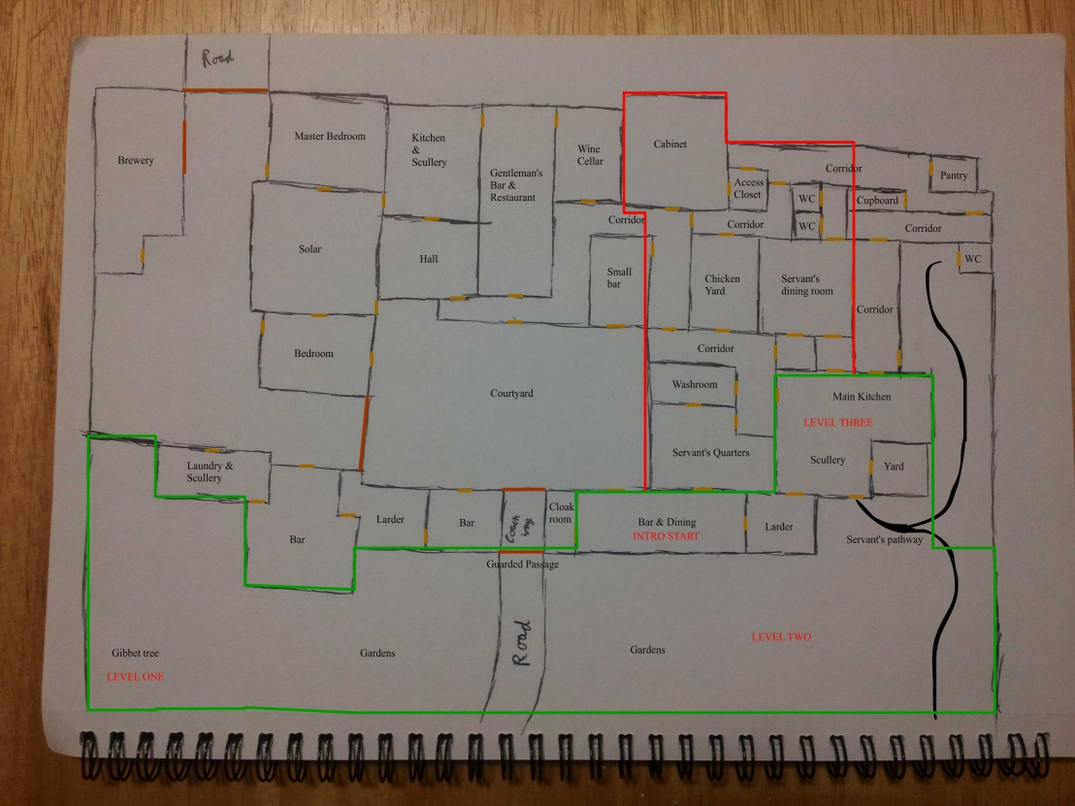
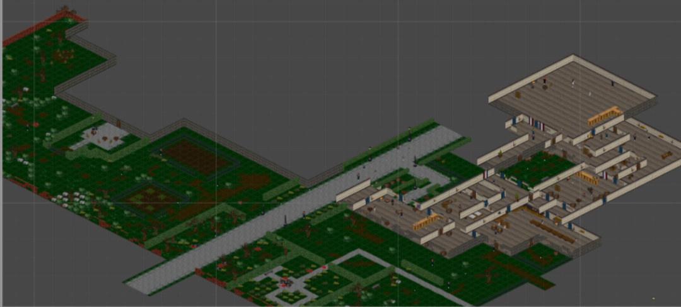
Game World

Slide 5
Playtesting Feedback
Playtesting throughout has revealed the difficulty of fully utilising our mechanics; as well as improvements to UI, controls, & theming.
Later playtesting showed the gameplay is mostly working as intended.
Target audience (16-30 male achievers) engaged with the game and enjoyed most of the puzzles.
Testers took between 30-50mins on average.

Slide 6
Evaluation
The choice of genre and perspective (isometric) made for a challenging development process.
Skin-wearing mechanic was powerful and sometimes made it difficult to integrate more diverse mechanics into the puzzles.
Our understanding of how to best use our chosen mechanics has improved significantly throughout the iterative process.

Slide 7
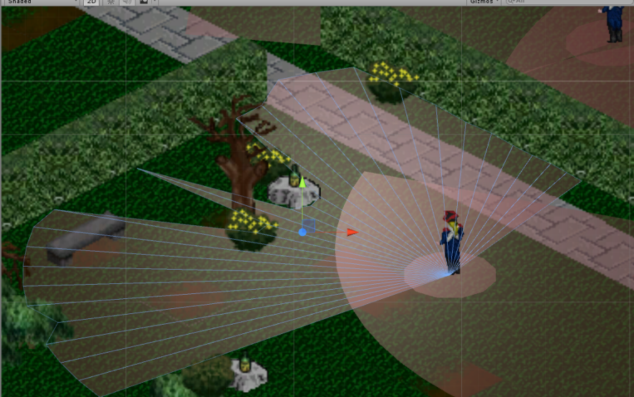
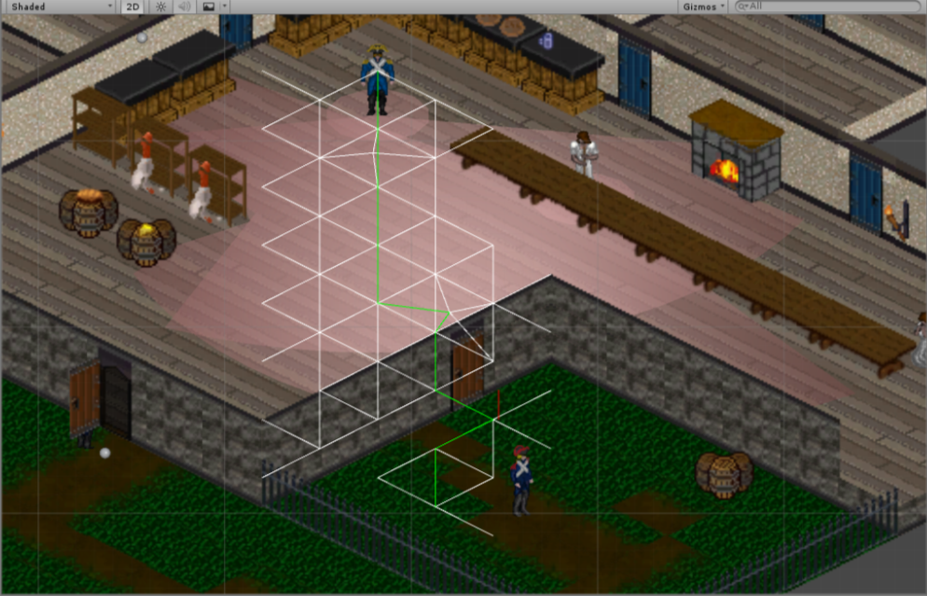
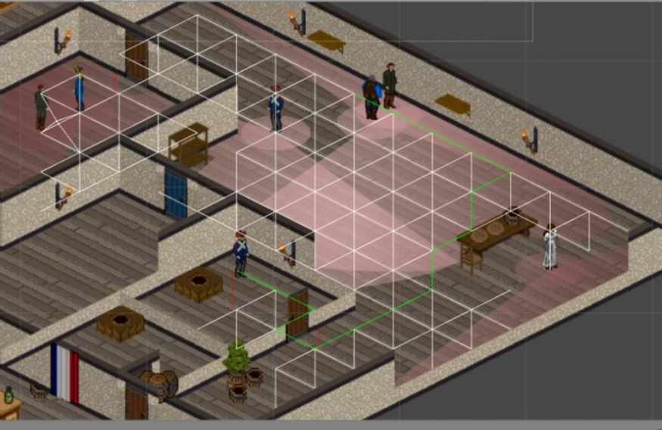
Evaluation: Code
Building an isometric world, viewcones (isometric mathematics), and sophisticated path-finding.

Slide 8


















Evaluation: Art
Drawing isometric perspective (2:1 aspect ratio), modular sprites, cel-style animation

Slide 9
Project Management
Team was compatible and worked consistently throughout, with weekly rotating management.
SVN kept tidy, with archived patch notes, builds, and documentation.
Hours Logged
Tom Kedik – 234.3h
Alaric – 213.25h
Total – 447.55h

Slide 10
What We Would Do Next
World-building animations
Audio & music
Adding puzzles which can explore how the mechanics can be used further, including the third skin ability
Expanding thematic elements & improving atmosphere
Saving & loading
Fix particularly persistent bugs

Slide 11
Conclusion
Largely we feel this project has been quite successful; allowing us to push ourselves with a challenging concept that has mostly managed to engage our target audience.
Questions?

